Slide 1

H172 35 - Object Oriented Analysis and Design
Airline Booking System Use Case Example

Slide 2
Airline Booking System “BryanAir” Book Flight

Slide 3
Airline Booking System
Customers want to BOOK FLIGHTS
They Login (and can register account etc. as necessary)
Then they enter a destination and a date they’d like to fly
Then they select their preferred flight from the available options
They enter the passenger info of who is travelling
If they wish, they can add optional extras like insurance etc.
They pay for the flight
The system creates a booking record in the system and sends a confirmation email

Slide 4
Use Case Diagram

Slide 5
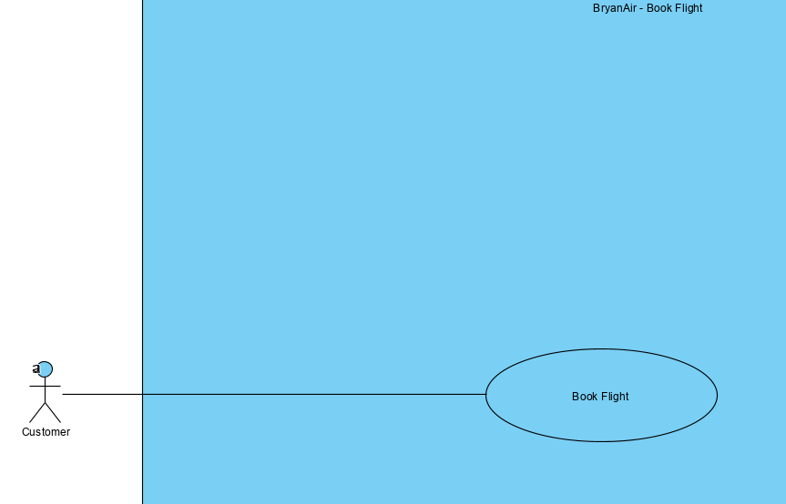

Slide 6
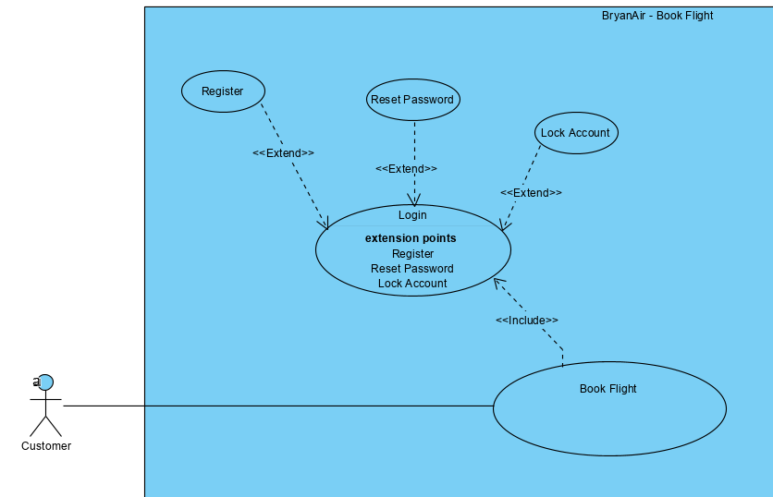

Slide 7
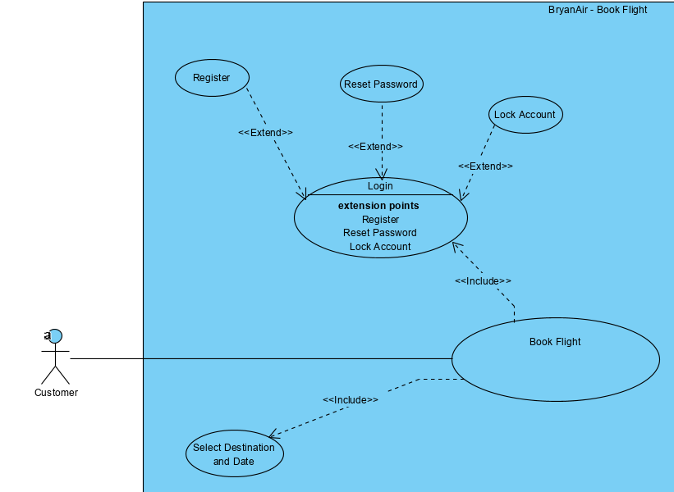

Slide 8
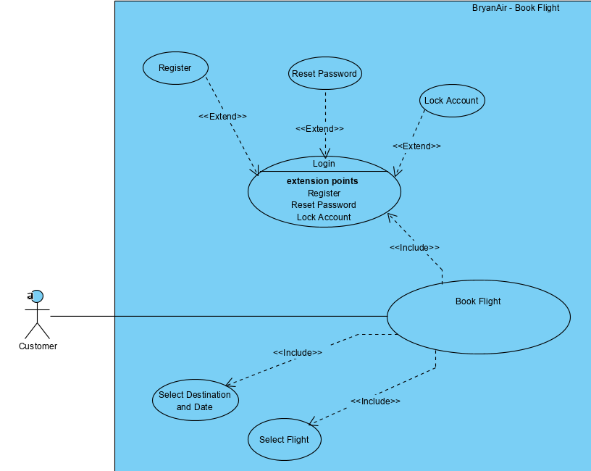

Slide 9
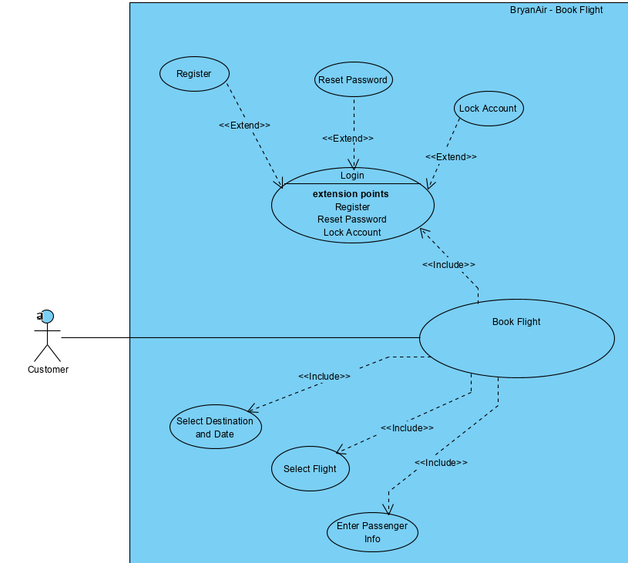

Slide 10
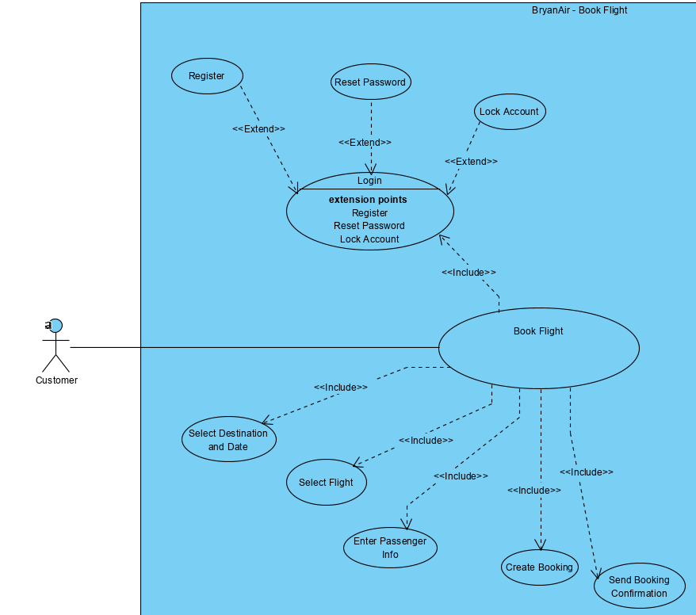

Slide 11
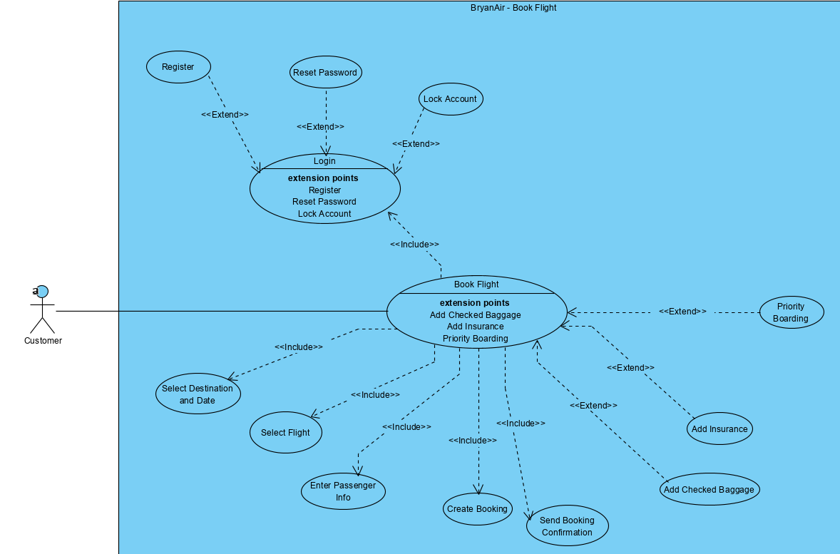

Slide 12
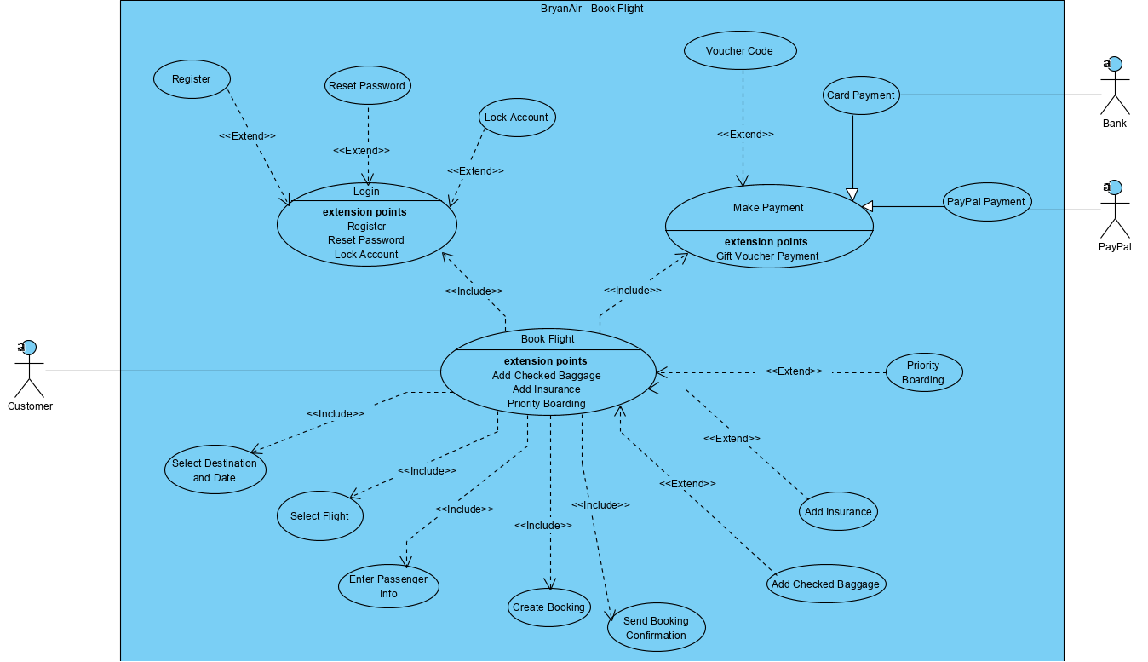

Slide 13
Use Case Documentation Examples Find 3 examples in the attached folder

